Slide 1
PPT-3 Class 9 Civics Chapter 3 - Electoral Politics

Slide 9
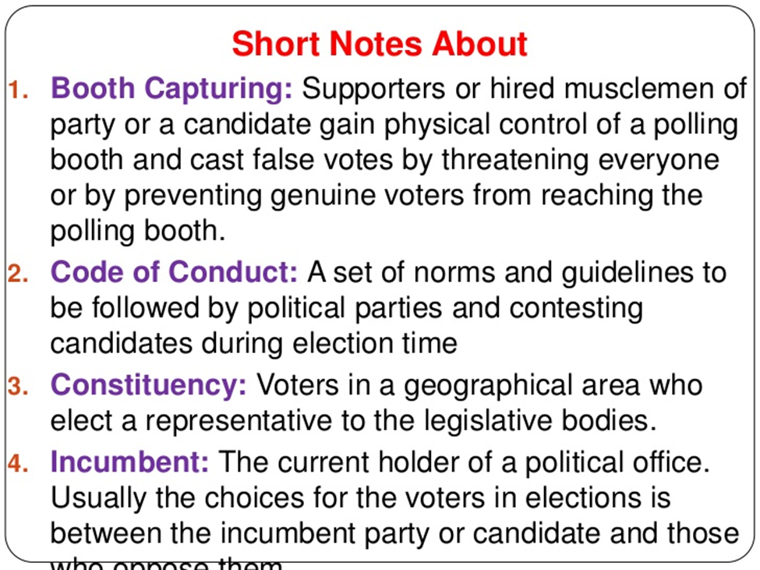

Slide 10
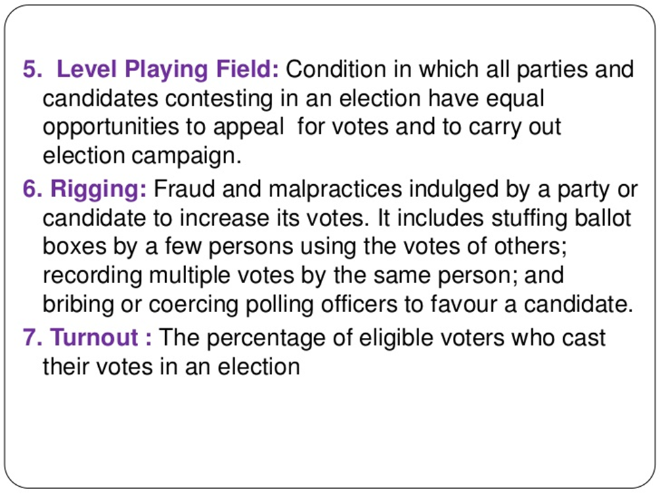

Slide 11
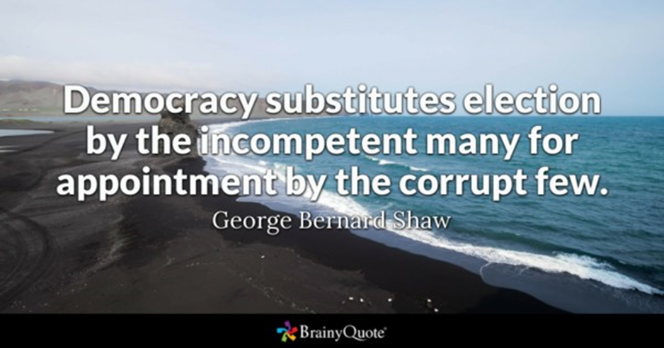

Slide 12
